Slide 1

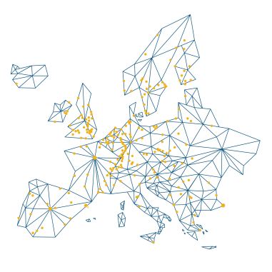
Title
Speaker (title)
Place, Date

Slide 2
420
libraries
ONE
mission
DEVOTED TO
OPEN SCIENCE
Policies, tools and infrastructures - reshaping research processes and mindsets in favour of Open.
WORLD-CLASS RESEARCH
Knowledge and training so that libraries can support outstanding research and — by extension — the growth and sharing of knowledge.

Slide 3
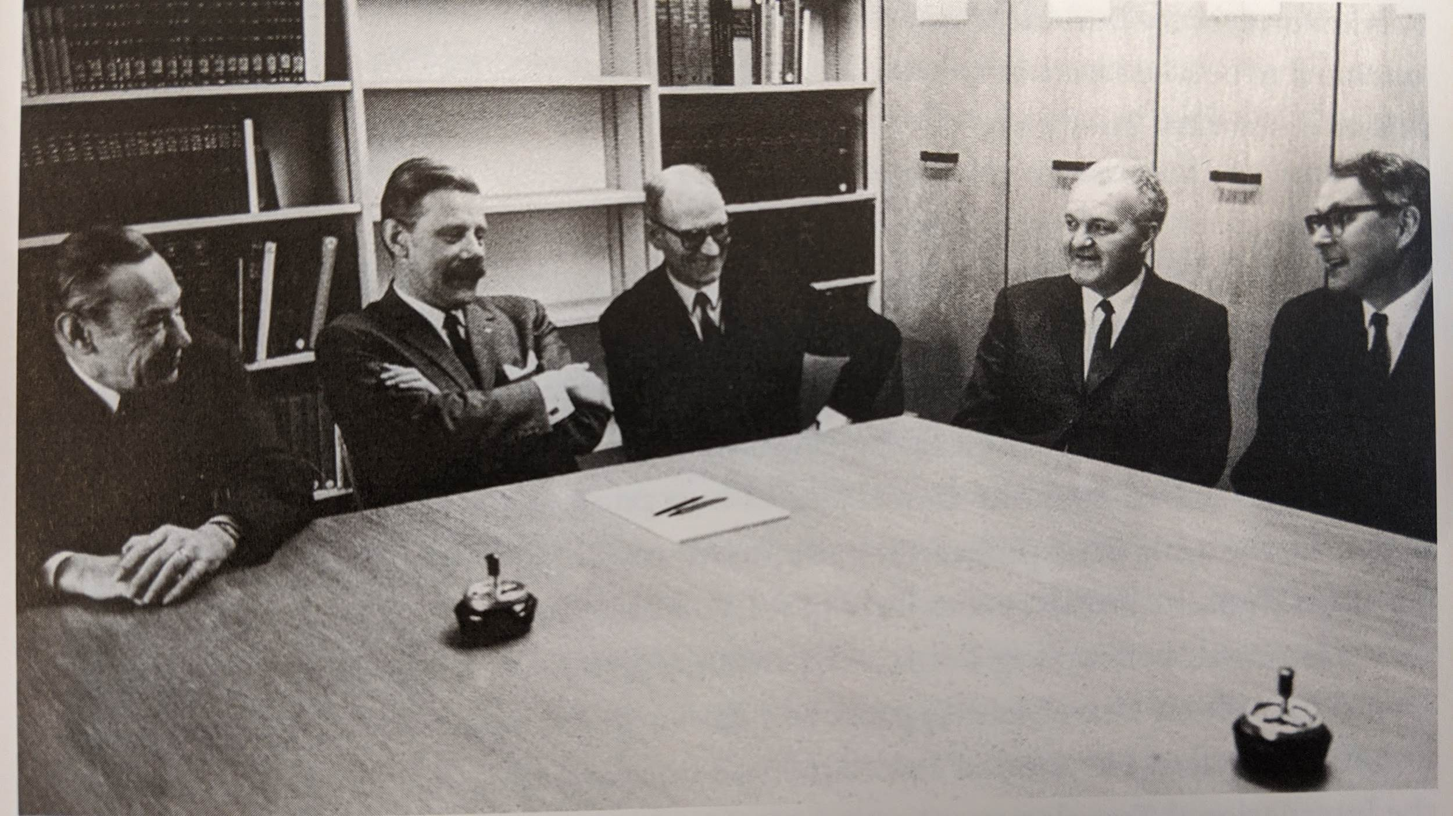
From a few founders in 1971

Slide 4
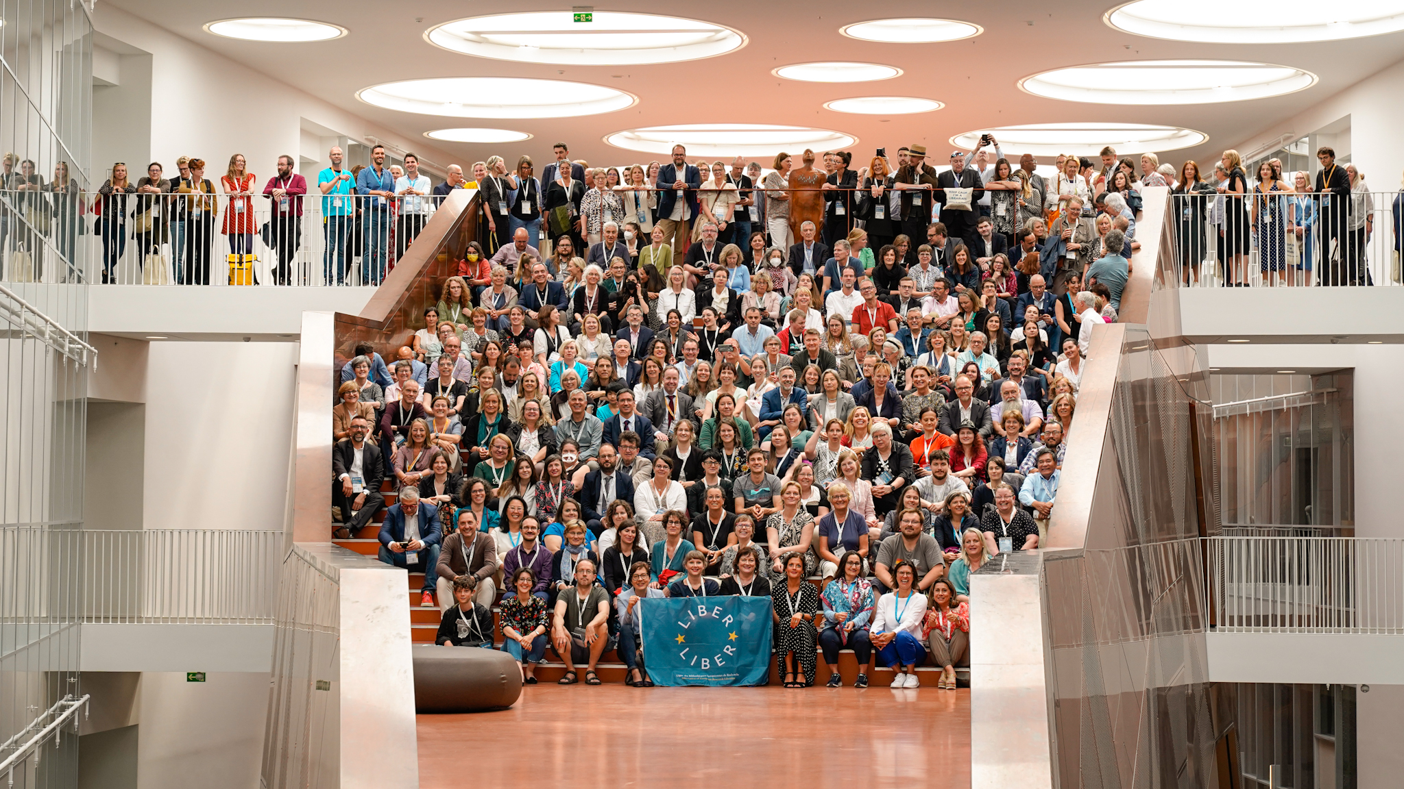
To a network in 40 countries
Notes:
Picture from the 2022 LIBER Annual Conference in Odense. The first in-person conference after two years of online conferences due to the pandemic.

Slide 5
“
Together with our libraries and partners, we enable world-class research.

Slide 6





World-Class Research Is...
Collaborative
Cross-discipline
Increasingly Data Intensive
Open
International

Slide 7
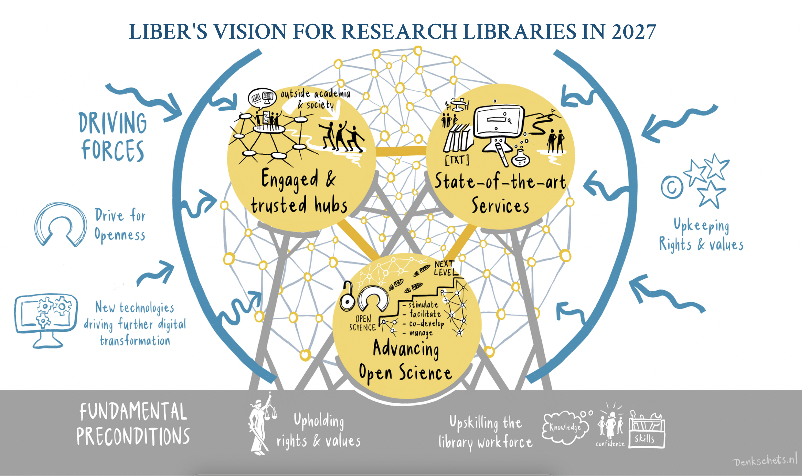
Notes:
To fulfil our ambition of enabling world-class research, LIBER launched a new 4-year strategy for the 2023-2027 period. The strategy outlines three driving factors (seen on the outside of the pictured diagram) impacting research libraries and LIBER:
Drive for Openness
A drive for Openness comes from academia, the broader society, European governments, and the European Union.
New technologies driving Digital Transformation
Artificial intelligence and other technological developments will accelerate the digital shift and profoundly affect research and scholarly communication.
Upholding Rights and Values
An increasing awareness and demand by society and academia to uphold rights and values in the digital scholarly environment.

Slide 8
Vision for Research Libraries in 2027
Research Libraries as Engaged and Trusted Hubs of their user communities, collaborating with each other and with local, national and international stakeholders in their role as change agents and facilitators, and driving public engagement in research.
Advancing Open Science in collaboration with researchers, research libraries stimulate, facilitate, co-develop, and manage infrastructures and practices designed to take Open Science to the next level.
1
3
Upholding Rights and Values By 2027, research libraries embody and uphold public and academic values of integrity, diversity and inclusion, inside and outside the research community.
4
State-of-the-art Services will be provided for collections, publishing and curation of information and (meta-)data. These services will be relevant to, and tailored for, user groups inside and outside academia.
2
Upskilling the library workforce so the staff of research libraries have the necessary knowledge, confidence and skills to take on the organisational and technological changes enabling the new roles and tasks of research libraries.
5

Slide 9
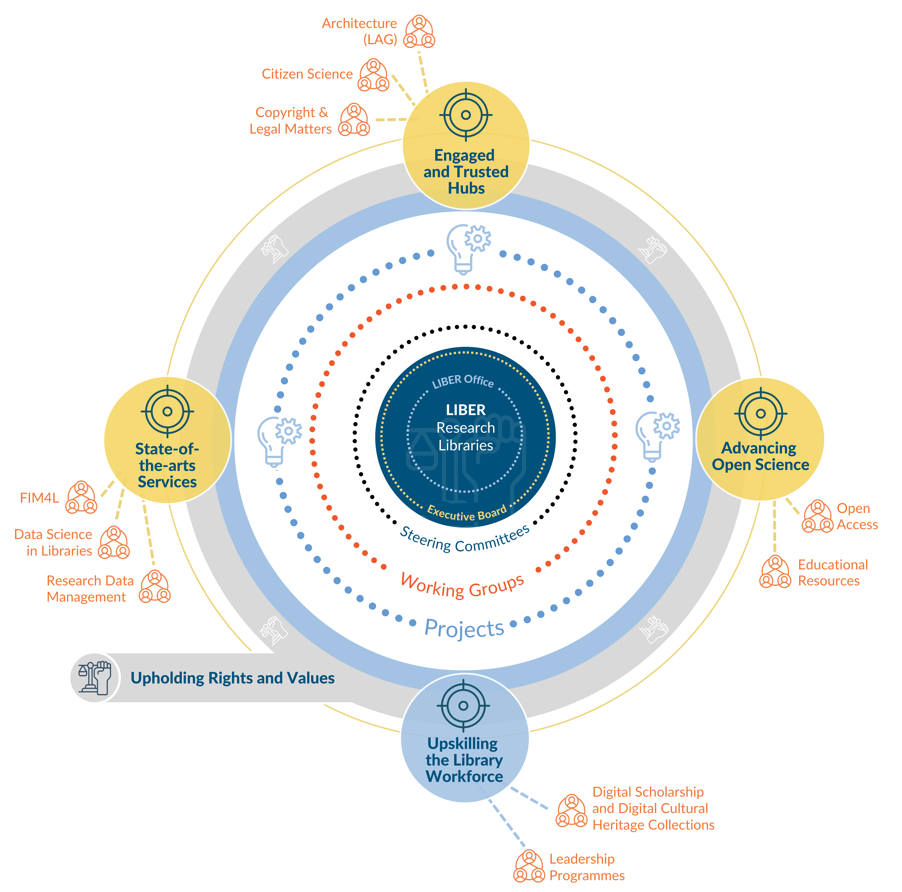
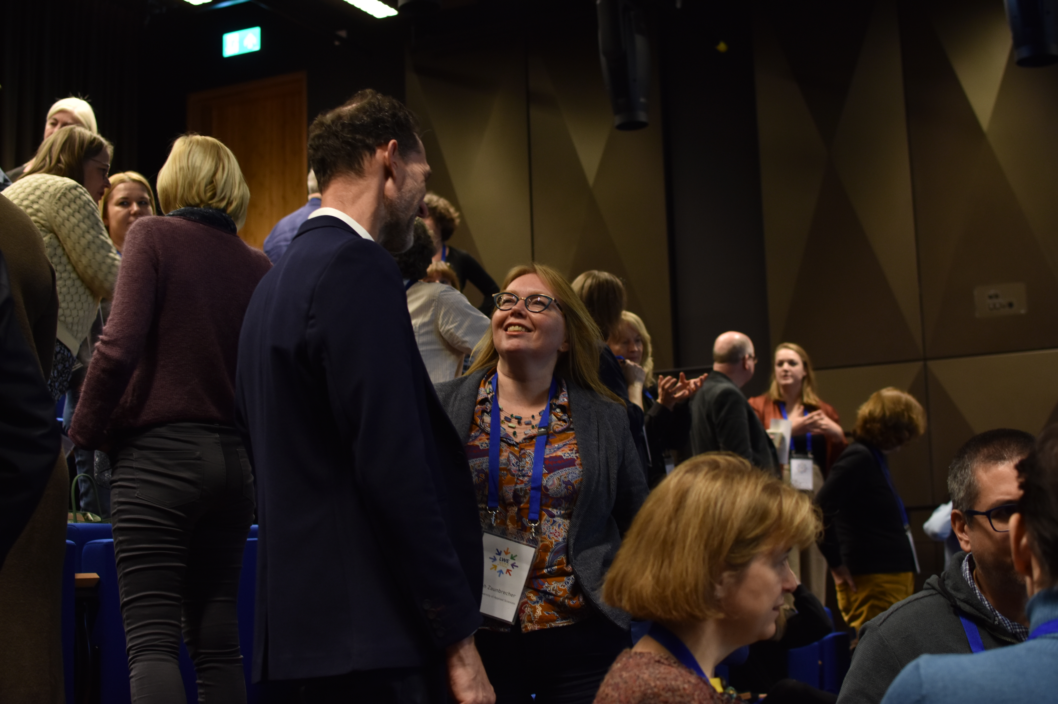
Innovation Through Collaboration
Notes:
The LIBER 2023-2027 Organogram shows how we will structure our efforts to fulfil our goals.

Slide 10

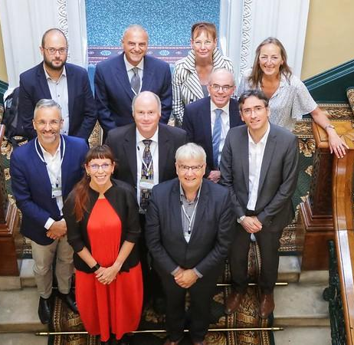














Global Partners
Speaking up with other library and research organisations for common values and collaborating on projects and strategic issues.
Notes:
LIBER works closely with a number of library and higher-education organisations in and around Europe.

Slide 11
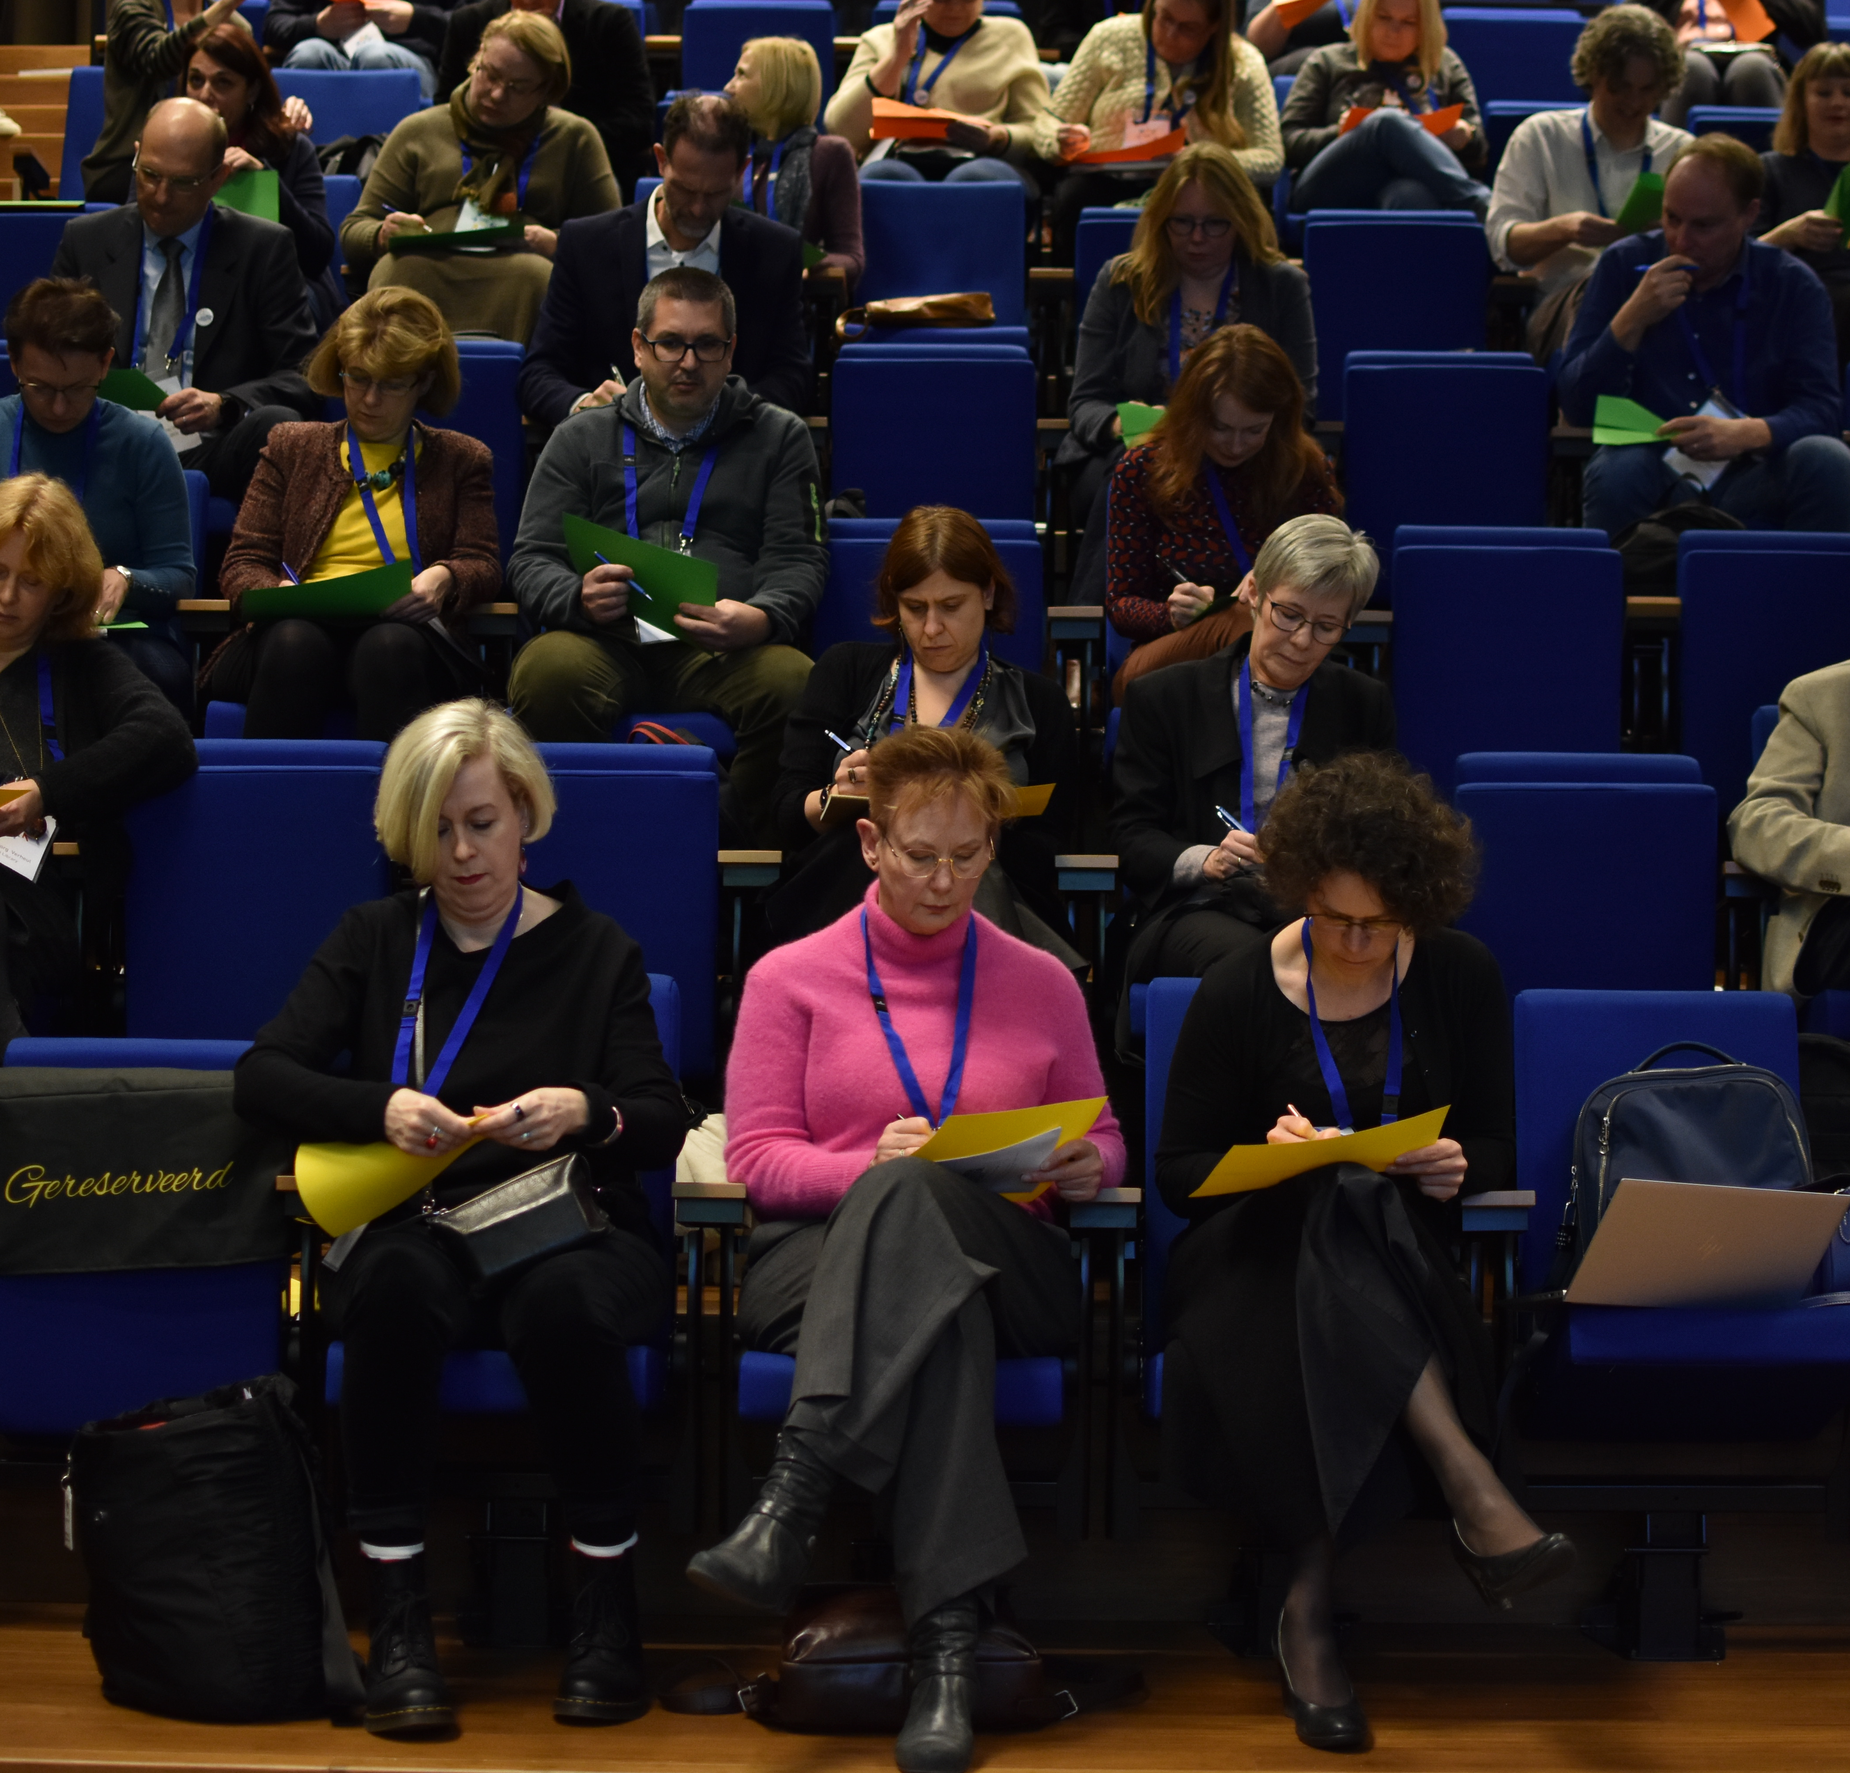
Main Activities
Networking | Learning | Training | Advocacy

Slide 12
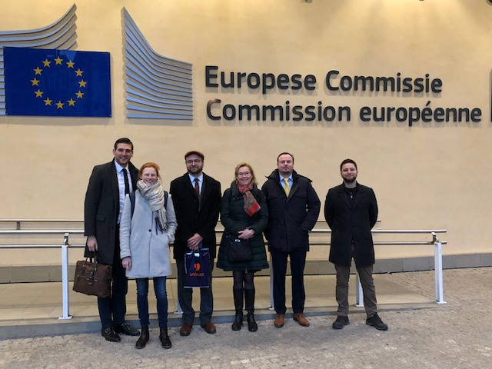
Advocacy
Putting the priorities of research libraries and their users on the European policy agenda.
Instrumental in achieving a TDM exception for research
Served on the EC’s Open Science Policy Platform
Called for better policy making procedures for education and science within the Digital Services Act.
Provide guidance so that libraries can advocate on a local and national level
Notes:
We work closely with the European Commission and other European institutions, arming them with evidence and presenting them with position statements, factsheets and other materials so that the priorities of research libraries remain high on their agenda.

Slide 13
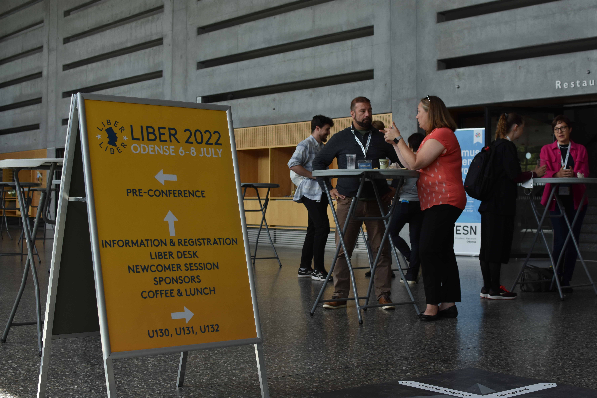
Conferences & Events
Annual Conference
Attended by 400+ research library professionals. Keynote Speakers. Workshops. Social Events.
Budapest, Hungary – 5-7 June 2023
Winter Event
Launched in 2022. Two days of dynamic, forward-looking sessions designed for and by the LIBER network.
Florence, Italy - 23-24 November 2023
Architecture Seminar
To further the exchange of experience between librarians and architects raise awareness of new projects and trends.
Brussels, Belgium - 24 April 2024

Slide 14
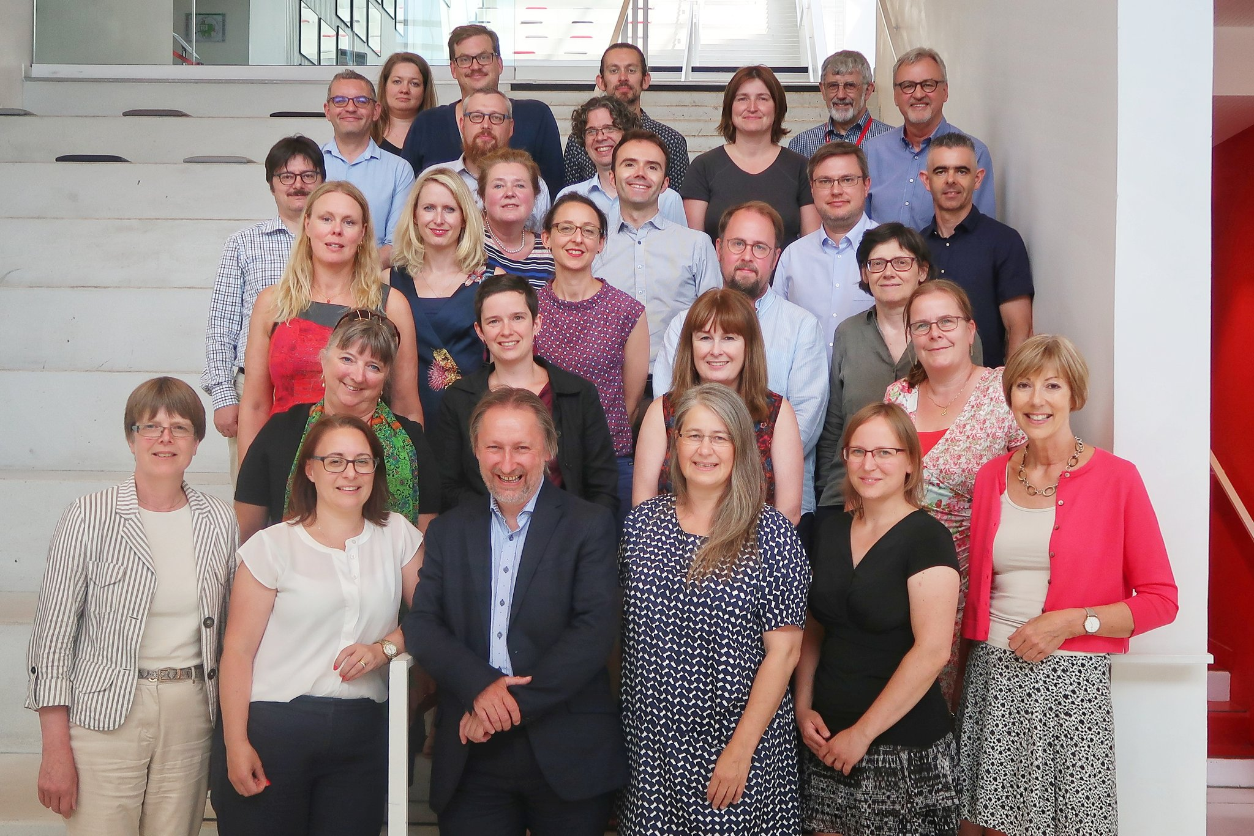

Leadership Seminars
Emerging Leaders
For the next generation of library leaders: classroom and action learning and a mentorship.
LIBER Journées
For existing library directors, forging bold new strategic paths.

Slide 15




Resources
Sharing insights and providing guidance on trends and current issues.
Reports
Factsheets
Webinars
Best-practices
Notes:
LIBER supports research libraries with reports, factsheets, case studies, webinars and other resources. These resources are created through our Working Groups, international project activities and collaborations with other leading organisations.
In addition, we share information through the LIBER Quarterly: a peer reviewed, open access journal which covers all aspects of modern research librarianship and scientific information delivery.

Slide 16



International Projects
We bring to projects the strengths and expertise of our network, in areas such as:
Leading the uptake of Open Science practices
Promoting Innovative Scholarly Communication
Supporting the development of digital skills and associated training activities
Fostering the development and use of research (e)infrastructures and services
Notes:
As of March 2023 LIBER has 8 active projects.
​
Project participation makes LIBER and our libraries more visible at a European and international level on important topics such as Copyright, Citizen Science and Open Access.

Slide 17
Join Us!
LIBER Europe’s Biggest Research Library Network
Notes:
Join Europe’s Biggest Research Library Network and help us to enable world class research. Staff from LIBER institutions actively contribute to our Strategy by serving on our Executive Board, participating in our Working Groups and as partners in International Projects. Together, we can make a difference.

Slide 18

Thank you
Questions?
[contact details]

